Slide 1
Valorant

Slide 2
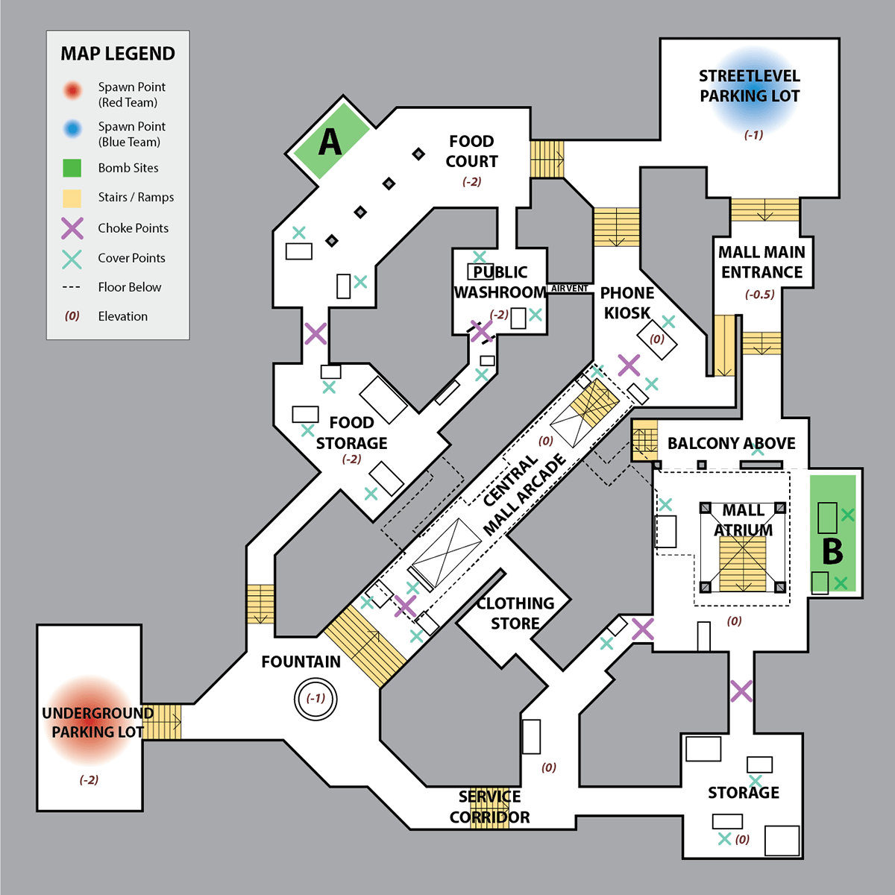
Valorant
Let’s design a Valorant map
Map from Call of duty

Slide 3
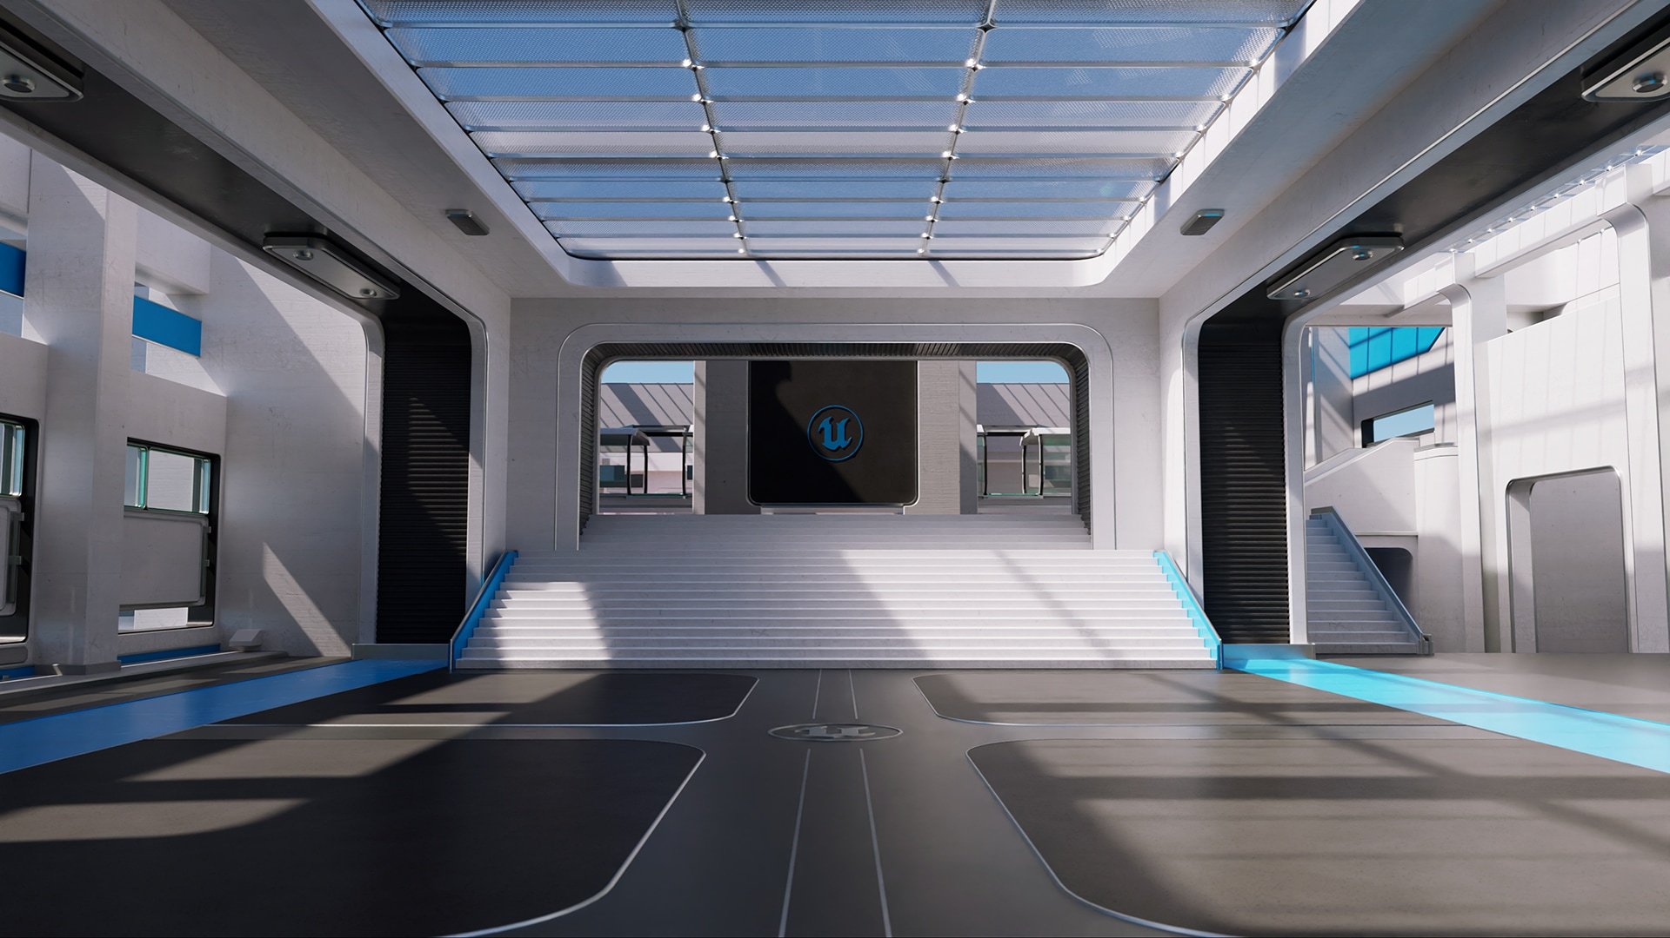
Valorant
Let’s design a Valorant map
1) Study existing maps
2) Design the map on paper
3) Test it with Unreal Engine
UE – Lyra project

Slide 4
Valorant
1) Study existing maps

Slide 5
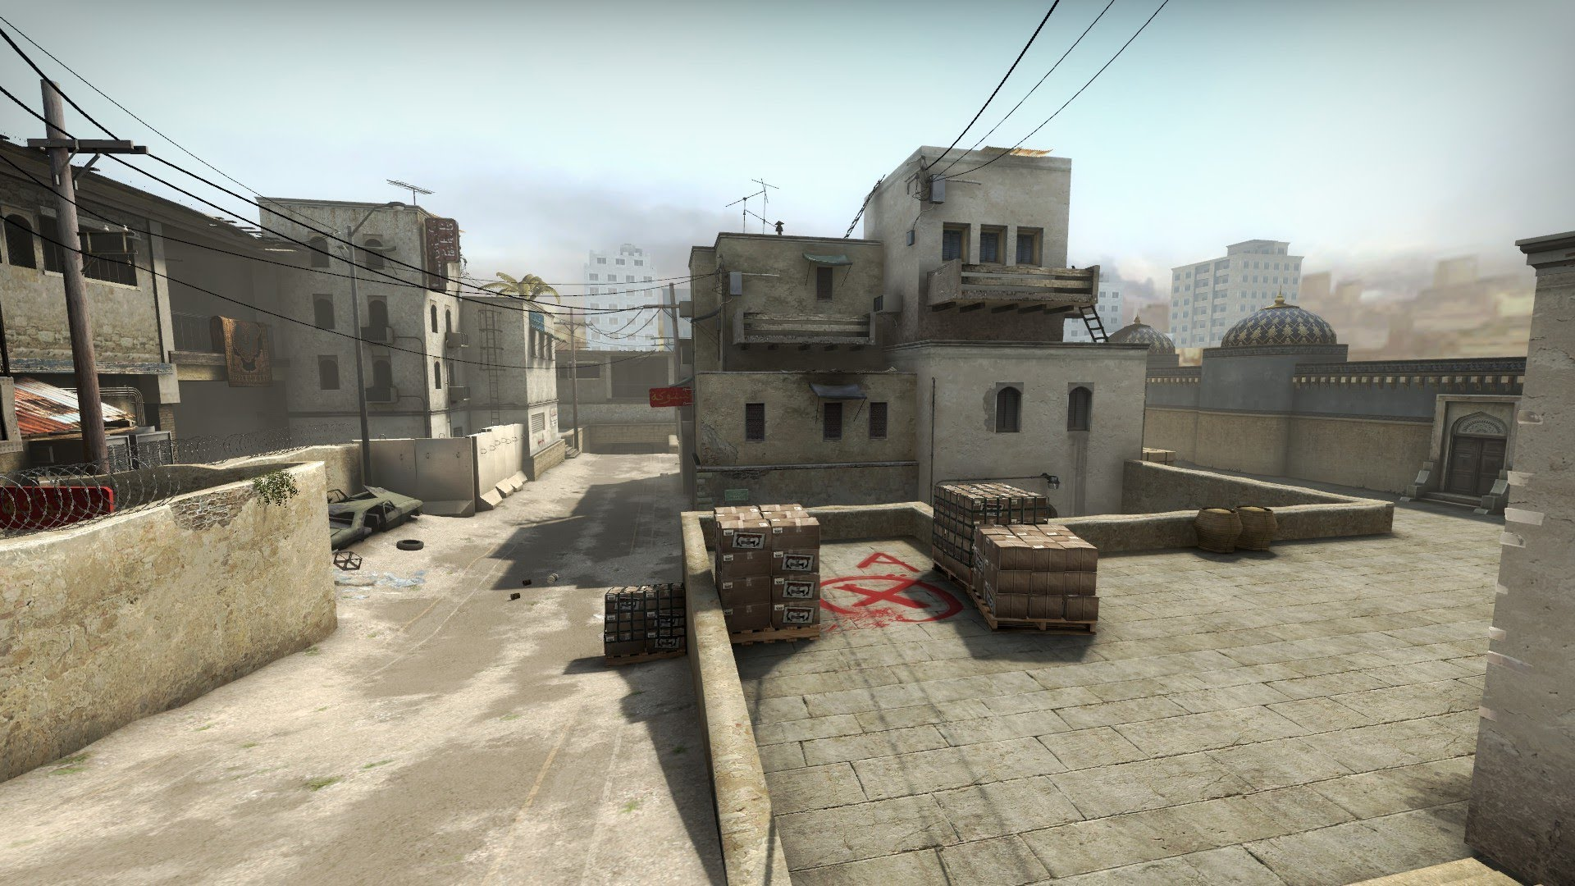
Valorant
Maps
The goal is to deeply understand how maps in Valorant work to be able to produce a map of the best possible quality.
I will mainly study the number of entry paths, the number of conflict lines and the number of trap positions for the defenders. WHY ?
Those numbers will guide me to create a competitive map : if every map has only 2 entry paths, I do not want to create a map with 10.
Entry paths
A direct path to a site (Not a flank).
Conflict lines
Very common line where defenders and attackers shoot the others.
Trap positions
How much opportunity do defenders have to hold their position on the site.
Dust 2 – CS:GO

Slide 6
Valorant
Ascent

Slide 7
Valorant
Ascent
location
Italy, Venice
Spike Sites
Two sites
Dynamic ELEMENTS
Irreversible bomb doors – 500 HP
Map size
Short

Slide 8
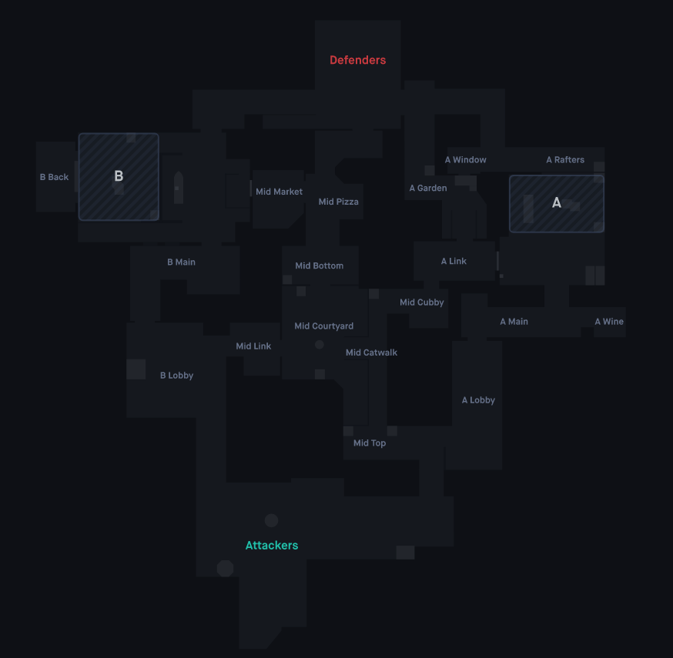
Valorant
Ascent
A few symbols to understand the map
General
Orb
Attack barrier
Defence barrier
Conflict line
Defense/Attack
/ Wallbang
/ Smoke
/ Molotov
/ Flash
/ Sage wall
/ Target (Doors / Switches)
Defense Attack
Trap position Stack position
Slow sage
Agressive push

Slide 9
Valorant
Ascent - B
Attack B - (Phase 1)
➔ 2 entry paths
Main
1 conflict line
Narrow corridor (vulnerable to shock darts, paints shells, wallbang)
Mid
4 conflict lines
Pretty open
Spawn attack
Spawn defence
Conflict lines
Position studied
Wallbang

Slide 10
Valorant
Ascent - B
DEFENSE B - (Phase 1)
➔ 2 entry paths
Main
1 close range trap position
1 good wall (reducing a lot of view)
Mid
2 close trap position
1 range trap position
2 smokes to control mid
1 information wall (if destroyed, you know mid is occupied)
Spawn attack
Spawn defence
Position studied
Trap position
Smoke defense
Wall position
Wallbang

Slide 11
Valorant
Ascent - B
Attack B - (Phase 1)
➔ 2 entry paths
Main
No need of smoke, blinds
Usually conceded or line guarded by a Chamber/Jett [Dash save]
Mid
Need of 2 smokes
Spawn attack
Spawn defence
Position studied
Smoke attack
Wallbang

Slide 12
Valorant
Ascent - B
Attack B - (Phase 2)
➔ 2 entry paths
Main
4 conflict lines
Open area in front of you / left side
Switch to cover your left side
1 conflict line chosed by attackers
Mid Market
Long corridor, cannot really rush because 3 spot to check at the same time
Conflict line
Attack line
Position studied
Attack wall

Slide 13
Valorant
Ascent - B
DEFENSE B - (Phase 2)
➔ 2 entry paths
Main
1 close range trap position
Can be slow down with utility [Smoke/Molotov] mainly
Mid Market
2 close range trap position
1 very strong sage slow (Cover a long+large spot)
Position studied
Trap position
Smoke defense
Molotov
Slow utility

Slide 14
Valorant
Mid push
Ascent - B
Main push
Attack B - (Phase 2)
➔ 2 entry paths
Main
2 smokes = focus only on left side
Door switch easy to grab with a Jett / Omen / Raze [Dash]
Mid Market
Imperative smoke
Can check Pizza or Market with utility
Position studied
Smoke attack
Flash
Attack target

Slide 15
Valorant
Ascent - B
Attack B - (Phase 3)
➔ 3 entry paths
Main
3 conflict lines for Left Main
2 conflict lines for Agressive Main
Easy push by numerous players (Long and large corridor to peak)
Mid Market
4 conflict lines
Hard to peak, too much angles to hold
Flank
1 clonflict line
High risk (Peak with 2 open spot)
but high reward (Direct view on a lot of space)
Conflict line
Position studied
Stack position

Slide 16
Valorant
Mid push
Ascent - B
Main push
DEFENSE B - (Phase 3)
3 entry paths
Main
2 close range trap position backsite
1 main trap position – Wallbang spot
Mid Market
If no one pushing Main, door switch is a priority target
1 smoke + molotov Market gives control back of the site to defence
- Flank
1 trap position
Trap position
Position studied
Smoke defense
Molotov
Slow utility
Wallbang attack

Slide 17
Valorant
Ascent - B
Main/Mid push
Attack B - (Phase 3)
3 entry paths
Main
Smokes futile if entry frags
No need of a lot of utility to take site
Key strat : Lock Main with utility
Mid Market
No easy utility to take site (especially left main defence)
➔ Need to stack or need players pushing Main
Flank
If position taken, easy to run (Narrow corridor) and huge kill potential (Really long line)
Door closed
Attack line
Position studied
Smoke attack
Flash
Molotov
Attack wall

Slide 18
Valorant
Ascent - A
Attack A - (Phase 1)
➔ 2 entry paths
Main
1 conflict line
Easy push because a lot of space [2/3 attackers peaking at the same time] + a way to climb on wall (extra peak)
➔ Defence cannot push as more than 2
Cubby
4 conflict lines
Pretty open
Push main + on Wall main
Spawn attack
Spawn defence
Conflict lines
Position studied
Stack position

Slide 19
Valorant
Ascent - A
DEFENSE A - (Phase 1)
➔ 2 entry paths
Main
1 sneaky trap position
Really good wall (reducing pusheable area, defenders still has clear lines).
Very fast push (Jett/Raze) with Omen blind
Mid
2 close trap position
1 range trap position
2 smokes to control mid
1 information wall (if destroyed, you know mid is occupied)
Position studied
Trap position
Smoke defense
Wall position
Blind Omen

Slide 20
Valorant
Ascent - A
Attack A - (Phase 1)
2 entry paths
Main
No real need of smoke, blinds
Easy push because a lot of space [2/3 attackers peaking at the same time] + a way to climb on wall (extra peak)
Mid
Need of 2 smokes
Spawn attack
Spawn defence
Position studied
Smoke attack
Flash
Molotov

Slide 21
Valorant
Ascent - A
Attack A - (Phase 2)
2 entry paths
Main
4 conflict lines
Easy to push but a lot of space for defence
TREE
2 conflict lines
No easy push (Small corridor) + pretty exposed behind [Mid Link + Mid courtyard]
Spawn attack
Spawn defence
Position studied
Smoke attack
Flash
Molotov

Slide 22
Valorant
Ascent - A
Defense A - (Phase 2)
2 entry paths
Main
1 entry trap position [Exposed from other path]
3/4 backsite trap position
Slowing down ennemies is not easy : raze/jett easy dashes
TREE
Not hard to defend but might get dangerous if A is getting pushed

Slide 23
Valorant
Ascent - A
Main push
Attack A - (Phase 2)
2 entry paths
1 flank
Main
Smoke on Rafters almost mandatory (Long up spot for snippers)
Box for Dash Jett + Smoke
TREE
Mid push
Jett target dash

Slide 24
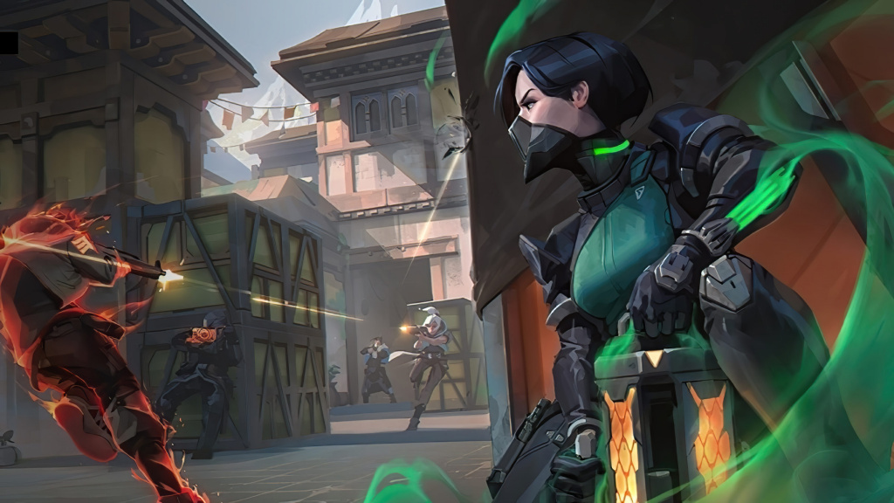
Valorant
Haven

